Slide 1

High Performance Leadership
270

Slide 2
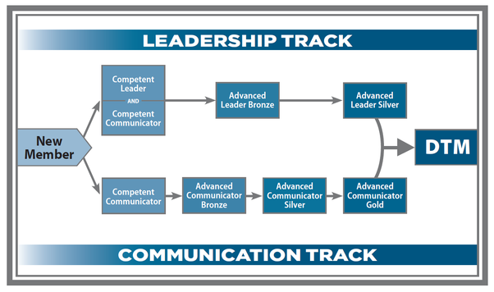
Advanced Leader Silver

Slide 3
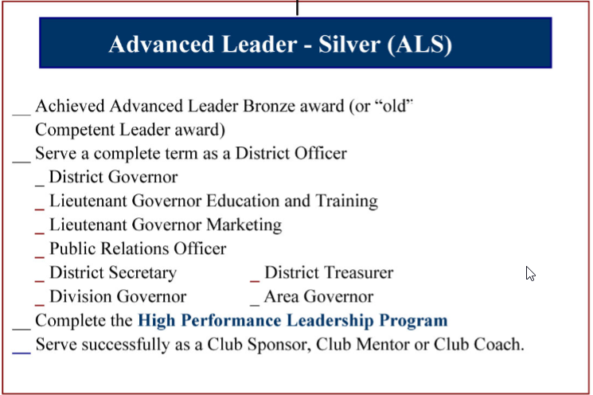
ALS Goals
1

Slide 4
HPL Steps
Order and read the HPL kit
Form an advisory committee of at least three members
Form action team of at least three members
Follow the steps to meet with advisory and action team
Organize and delegate
Get signoff completion at the end

Slide 5
Find a Project
Makeup Officer Training
TLI held twice a year
Makeup officer training held four times a year
Officers get DCP credit for attending

Slide 6
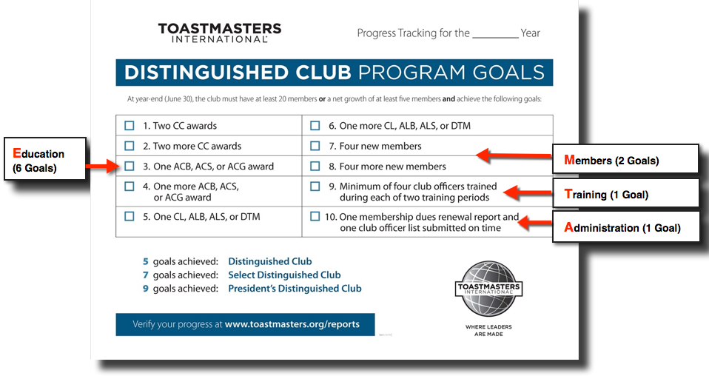
Incentive – Training & DCP Goal

Slide 7
Officer training steps
Create a sharable template
Tasks for room reservation
Tasks for setup/teardown
Tasks for advertising
Tasks for food
Ask the advisory team for ideas
Find a keynote speaker
Ask the action team to facilitate the seven officer trainings
Create agenda

Slide 8
Summary
CEO of your own event
Lead 6-10 people
Organize event of 50 people
Anywhere from 1-2 months planning and execution
Get your ALB on your way to DTM

